Slide 1


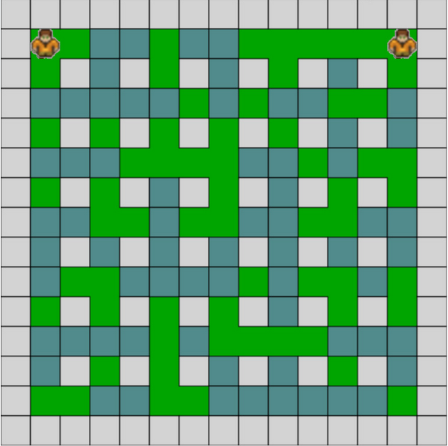







Speedy Bomberman
Hi there!
Don‘t get caught in the BOMB!
Runs in:
Google Chrome
Coded in:
Firefox
HTML5
Microsoft Edge
Canvas
Vivaldi
CSS Styles
Coded by:
Features:
Movement
Patrick Busch (2617417)
Multiplayer
Lucas Kühne (2617406)
Collisiondetection
High speed experience
Drop a bomb
Lucien Stenke (2617505)

